Slide 1

$17.50

Slide 2

N/A

Slide 3
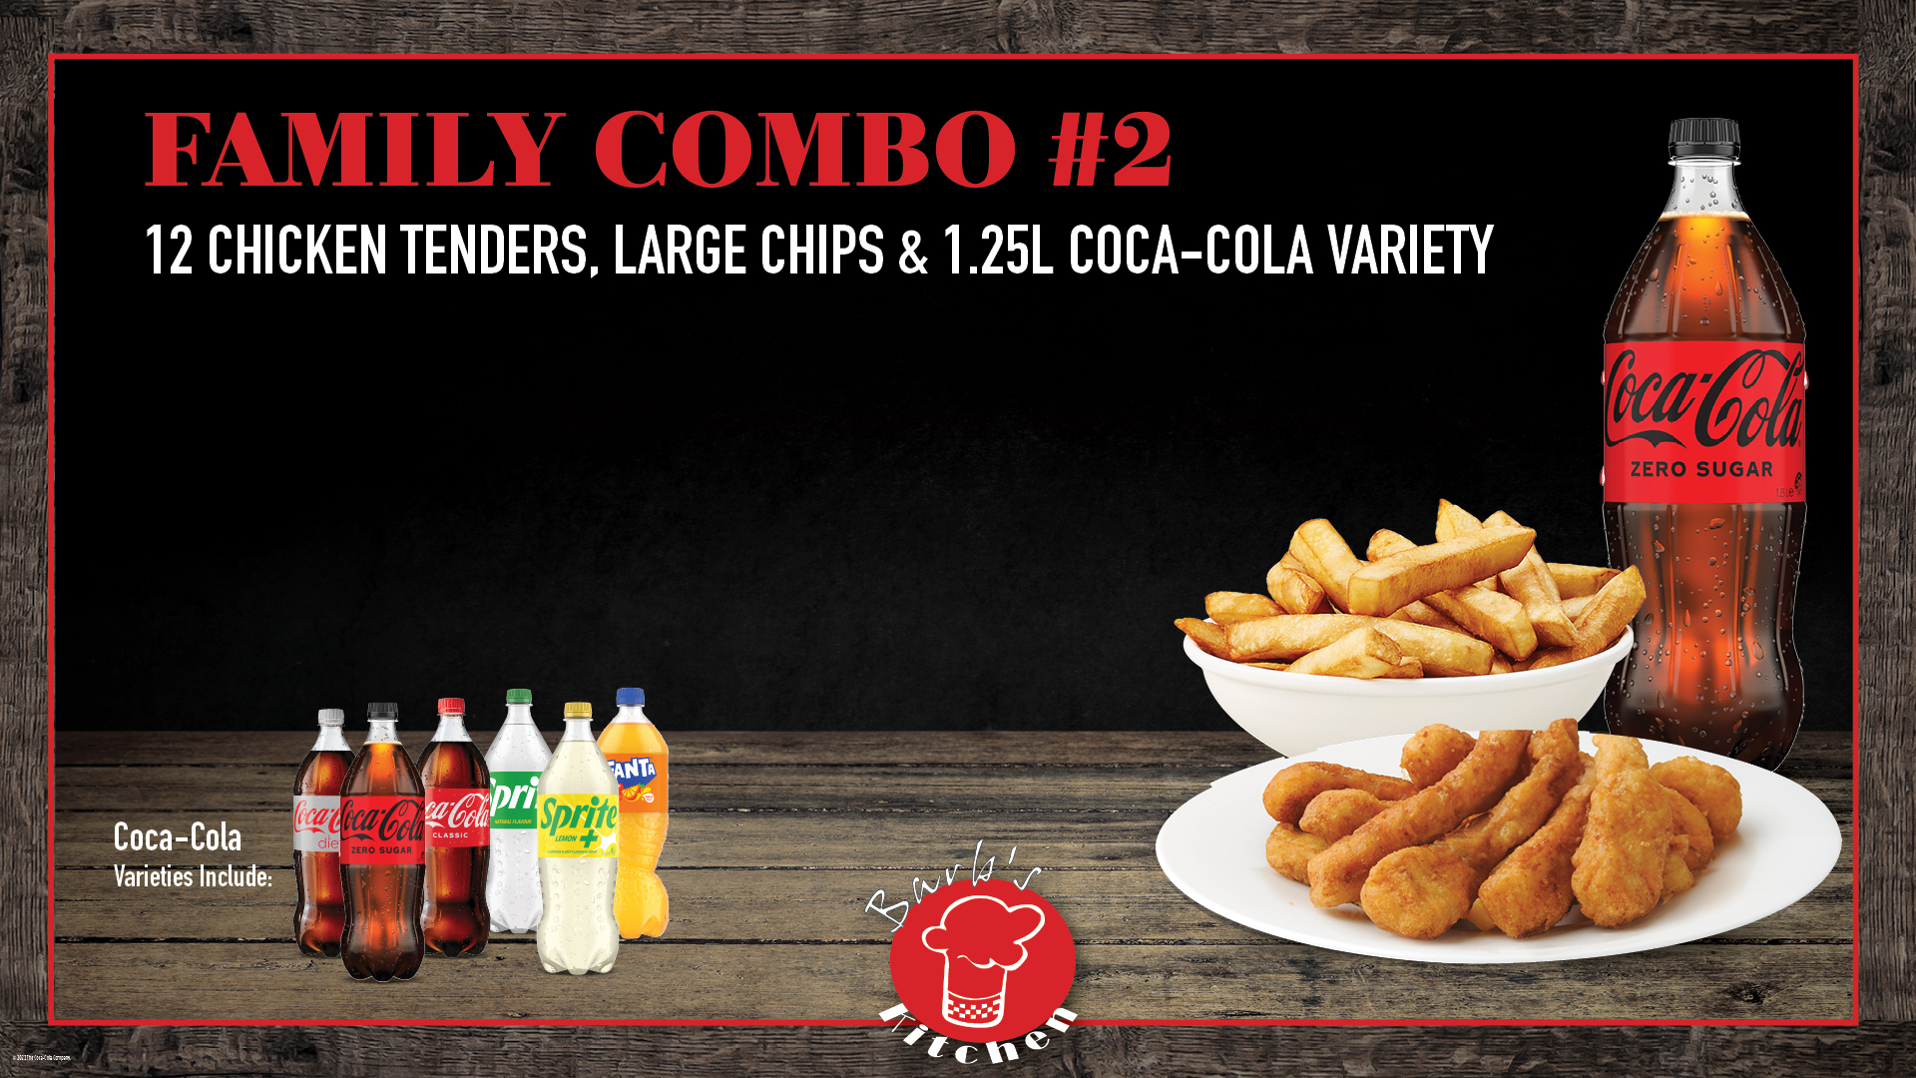
$39.95

Slide 4

$23.95

Slide 5

$24.95

Slide 6
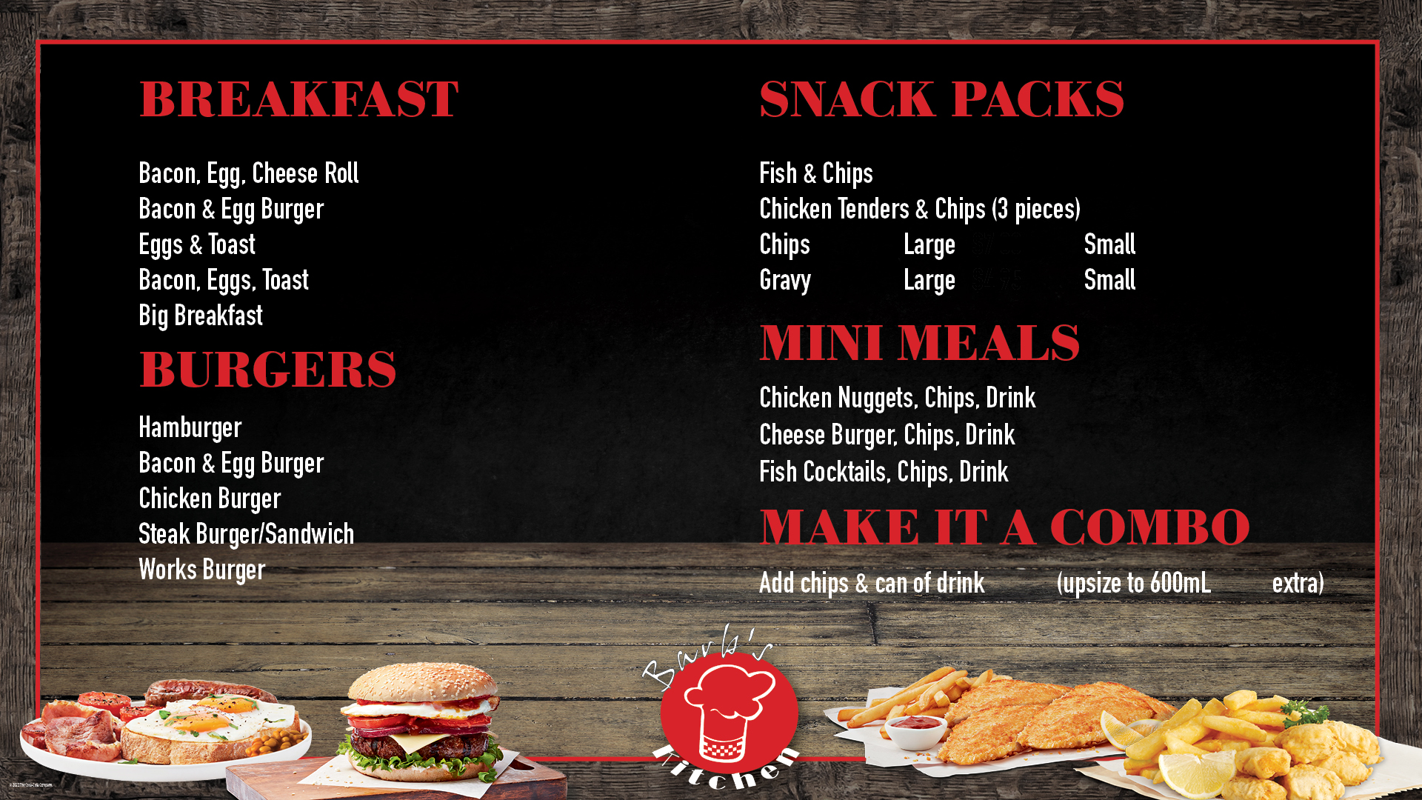
$8.50
$11.95
$9.95
$15.95
$19.95
$11.95
$11.95
$10.00
$6.00
$5.00
$4.00
$10.95
$10.95
$10.95
$11.95
$11.95
$14.95
$15.95
$15.95
$7.00
$2.00

Slide 7
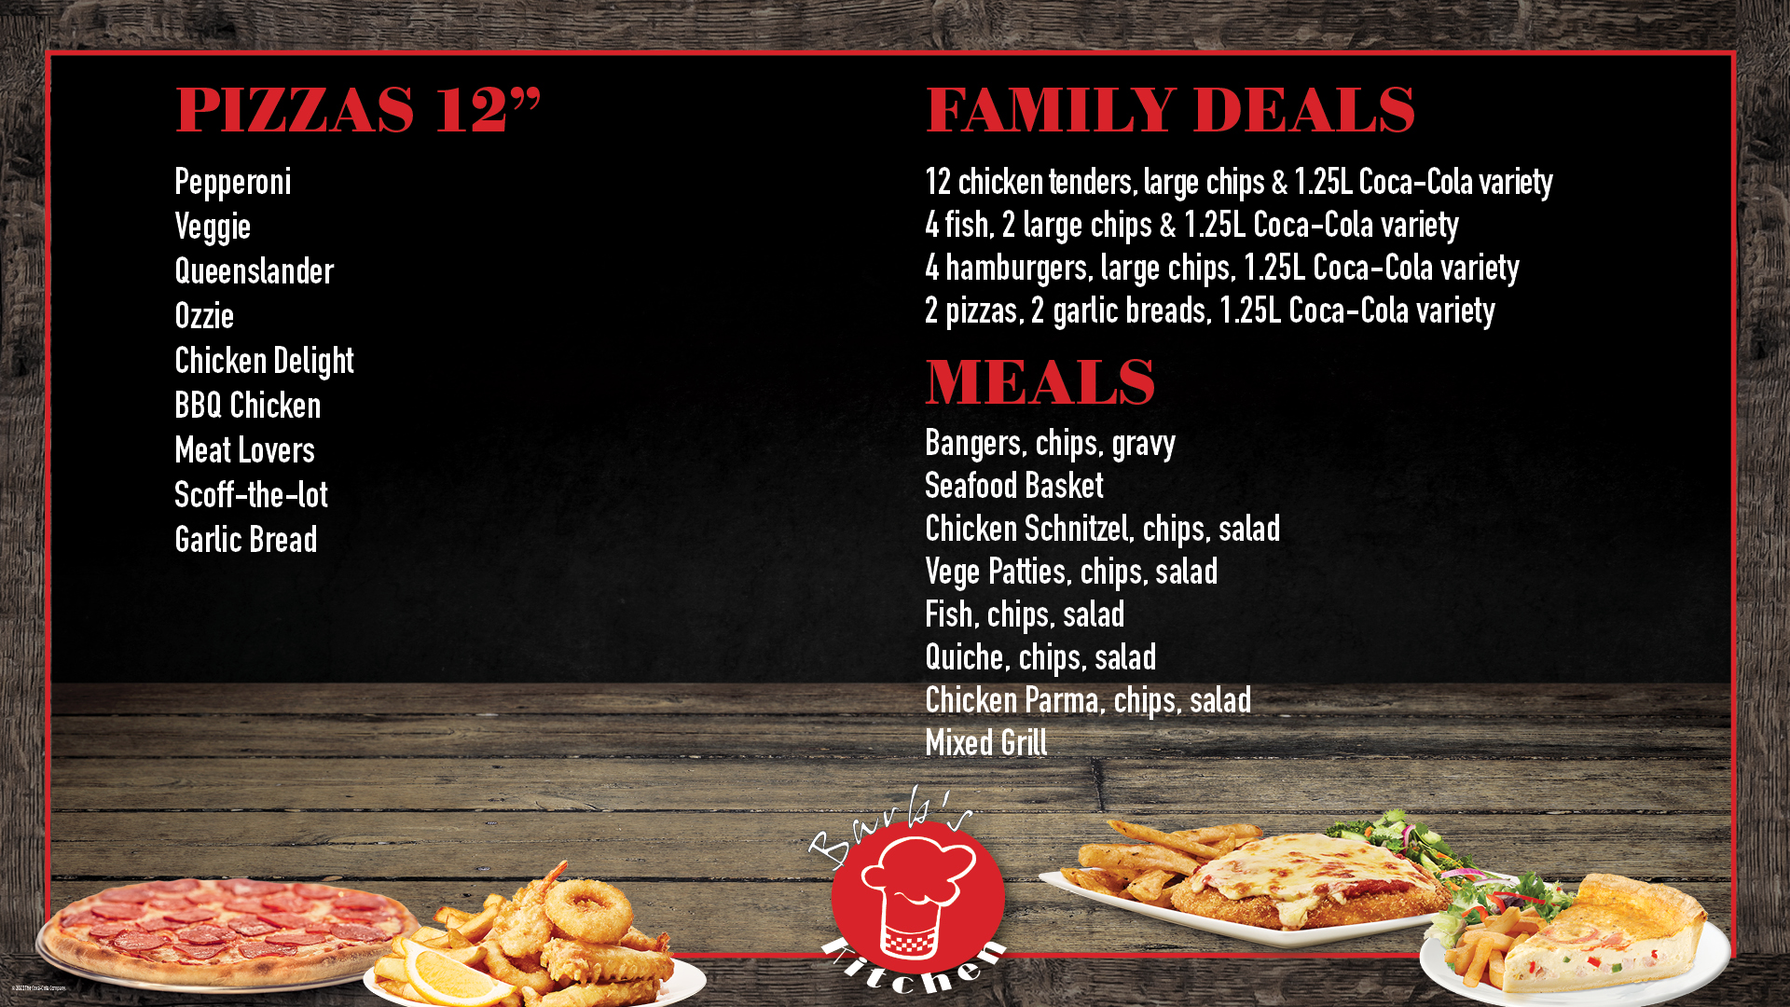
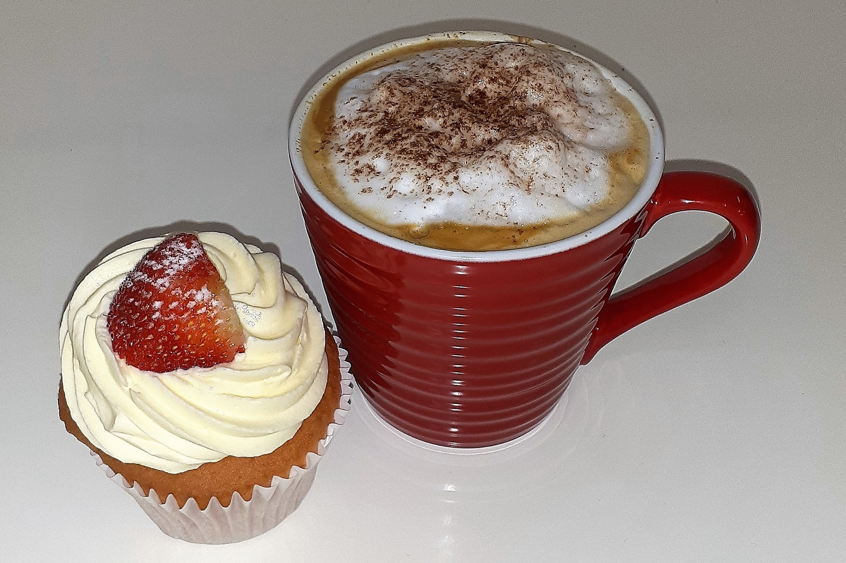
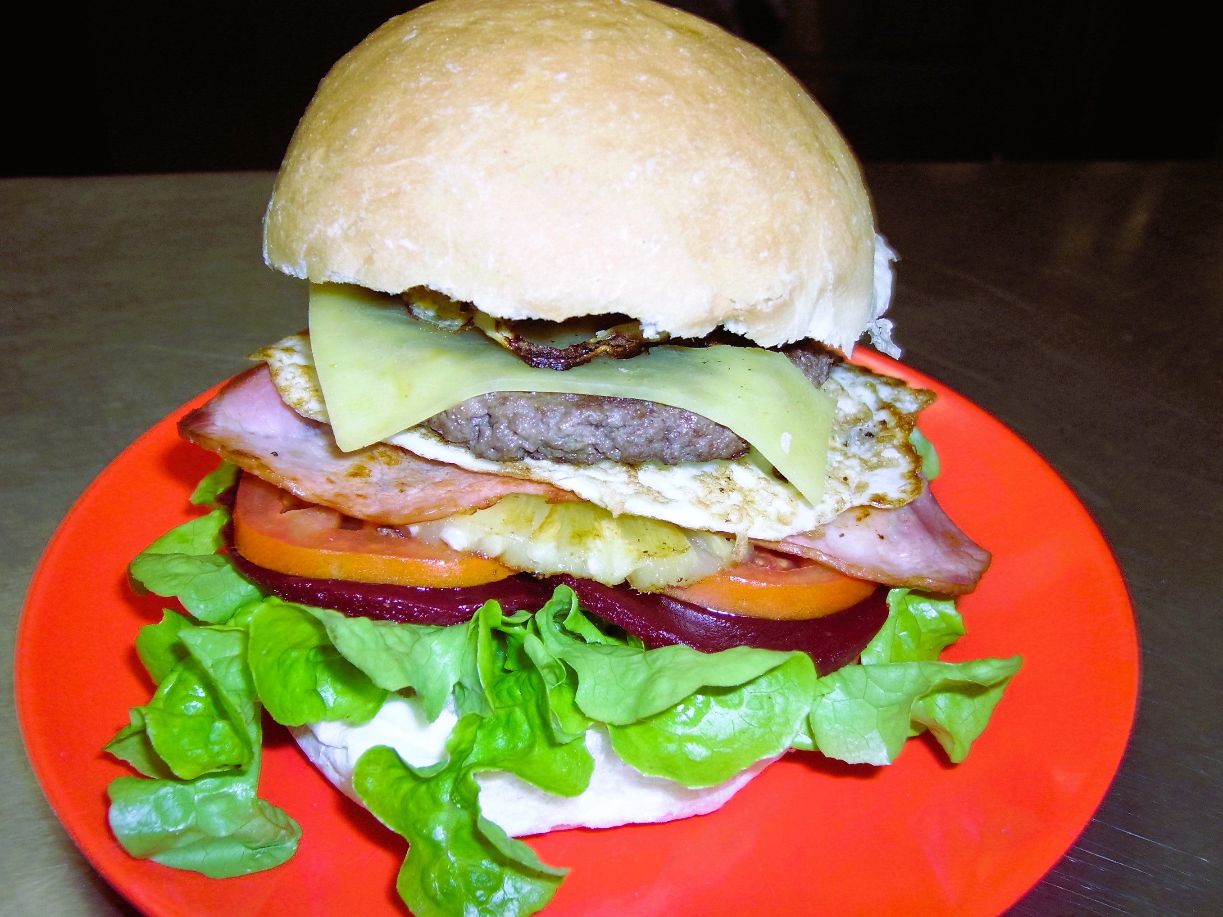
$39.95
$45.00
$59.95
N/A
$14.95
$16.95
$16.95
$15.95
$16.95
$15.95
$17.95
$19.95

